Slide 1

Amdocs Training Project
Abhishek Singh
180949

Slide 2
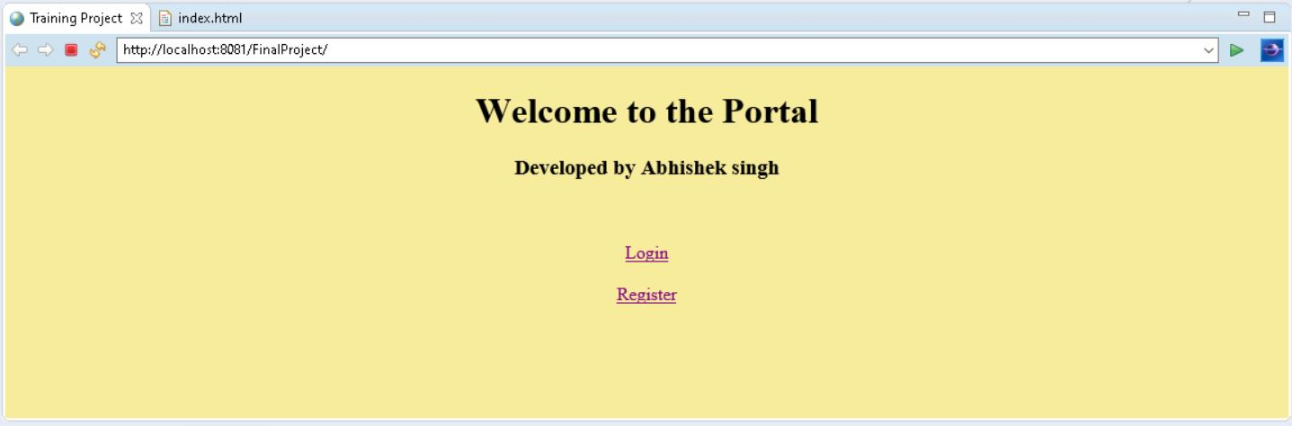
PROJECT FEATURES
New User Registration
User
View and Enroll Course
Give Feedback
View Admin
Admin
Add and View Course
View Feedback
View Admin and User
Add New Admin

Slide 3
Technology Used
Server
Apache Tomcat 9
Backend
Java Servlet
Frontend
JSP
HTML/CSS
Database
Oracle

Slide 4
PROJECT STRUCTURE
com.Amdocs.main
LoginServlet
Login
DBConnect
Course
com.Amdocs.user
UserServlet
User
UserRegisterServlet
MyCourseServlet
EnrollCourseServlet
AdminServlet
ViewCourseServlet
ViewAdminServlet
ViewFeedbackServlet
ViewUserServlet
com.Amdocs.Test
UserTypeDetectionTest
FeedbackServleet
com.Amdocs.admin
Admin
AdminRegisterServlet
AddCourseServlet
LogOut Servlet
Feedback

Slide 5
Log in
Return User Type
LoginServlet
Call Login Function
Login Class
Call From Login Button
Wrong password
2- User |3 - Admin
1- Admin | 0 – User | 5- User Not Found
User Type
Admin Servlet
User Servlet
User Register Servlet

Slide 6
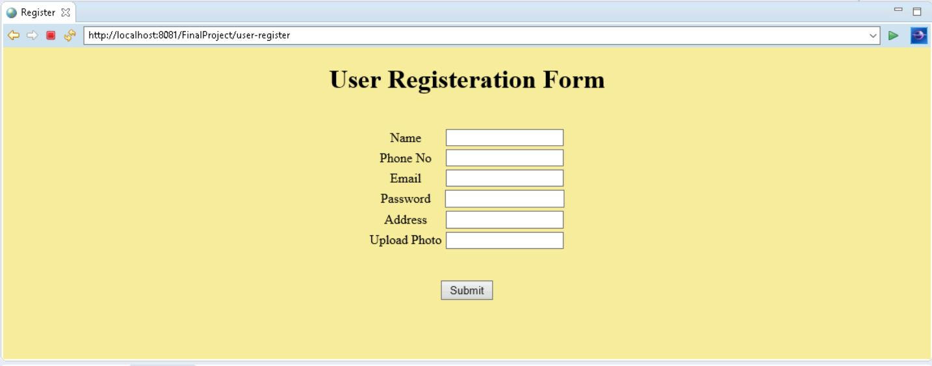
ADD USER
UserRegisterServlet
User Object Creation
User
// Class
Successful Registration
UserServlet
Insert Into Database
Create New Session

Slide 7
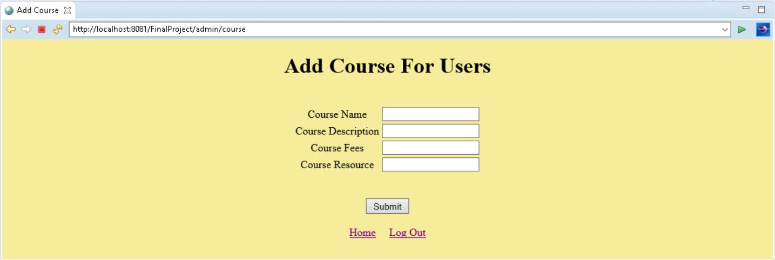
ADD CoURSE
AddCourseServlet
ADD course in Database
Call Course Class
Course (Class)
View Course After Addition
Success Addition
ViewCourseServlet

Slide 8
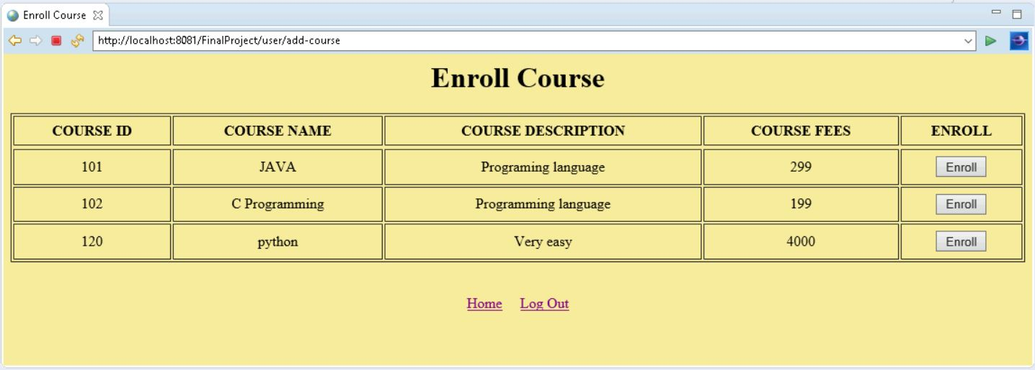
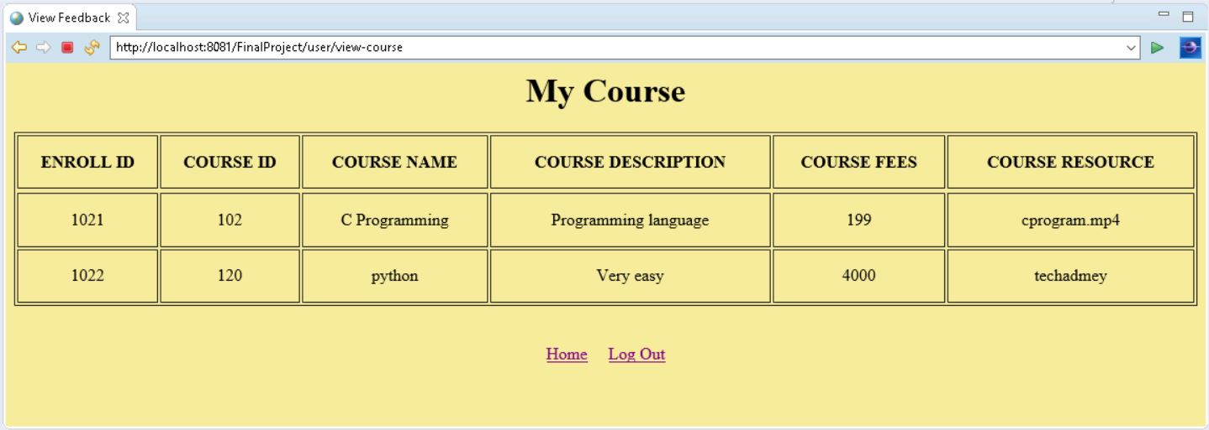
ENROLL COURSE
enrollCourseServlet
Enroll Course
Course.enrollCourse()
Successful Entry
ViewCourseServlet
Insert Into Enroll Table
View List of Courses

Slide 9
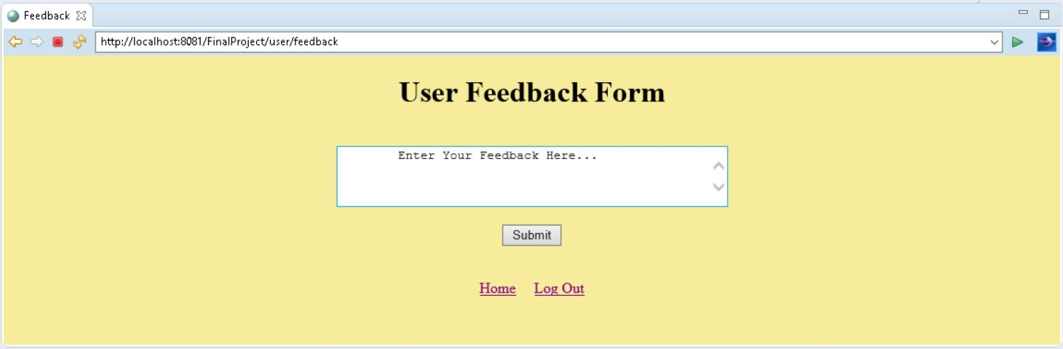
ADD FEEDBACK
submitFeedbackServlet
SubmitFeedback
Feedback.submitFeedback()
Successful Entry
View Feedback Id

Slide 10
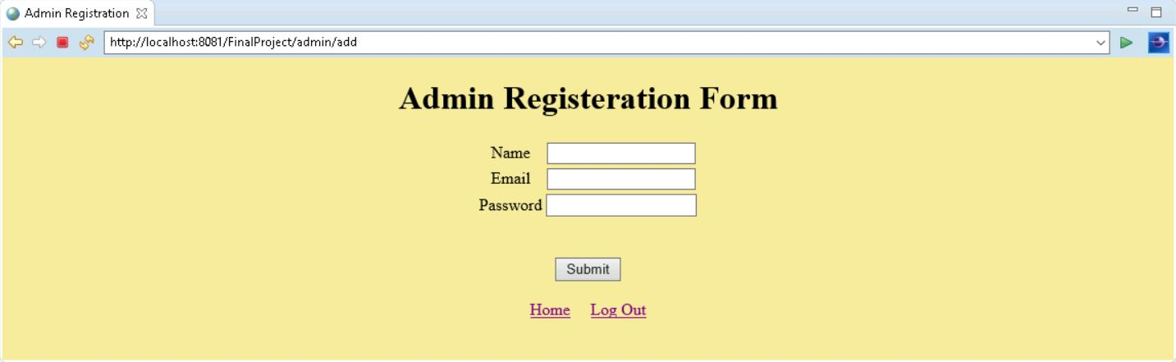
ADD ADMIN
Admin Add new Admin
AdminRegisterServlet
User Object Creation
Admin
// Class
Successful Registration
AdminServlet
Insert Into Database
Create New Session

Slide 11
OTHER FUNCTIONS
Log Out
request.getSession().invalidate();
View FeedBack
ViewFeedback Servlet
Select * from feedback;
View User
ViewUserServlet
Select * from user1;
View Admin
ViewAdminServlet
Select * from admin1;
View Course
ViewCourseServlet
Select * from course;

Slide 12
MISCEllanous
ENVIRONMENT
IDE – Eclipse
Git – For Version Control
Github – Source Code Repo
https://github.com/abhishek-singh-IN/Amdocs-Training-Project
SOURCE CODE
Session – For Storing logged in User Details
Junit 5 – Testing

Slide 13
PL/SQL Functions
ADD COURSE
CREATE OR REPLACE FUNCTION addCOURSE(
p_course_name IN COURSE.C_NAME%TYPE,
p_course_desp IN COURSE.C_DESP%TYPE,
p_course_fees IN COURSE.C_FEES%TYPE,
p_course_resource IN COURSE.C_RESOURCE%TYPE)
RETURN COURSE.course_id%TYPE IS
p_course_id COURSE.course_id%TYPE;
BEGIN
p_course_id := course_id.nextval;
INSERT INTO COURSE ("COURSE_ID","C_NAME","C_DESP","C_FEES","C_RESOURCE")
VALUES (p_course_id,p_course_name,p_course_desp,p_course_fees,p_course_resource);
COMMIT;
RETURN p_course_id;
END;
ENROLL COURSE
CREATE OR REPLACE FUNCTION enrollCOURSE(
p_user_id IN ENROLL.enroll_id%TYPE,
p_course_id IN ENROLL.course_id%TYPE)
RETURN ENROLL.ENROLL_ID%TYPE IS
p_enroll_id ENROLL.ENROLL_ID%TYPE;
BEGIN
p_enroll_id := enroll_id.nextval;
INSERT INTO ENROLL ("ENROLL_ID", "USER_ID","COURSE_ID")
VALUES (p_enroll_id, p_user_id, p_course_id);
COMMIT;
RETURN p_enroll_id;
END;
SUBMIT FEEDBACK
CREATE OR REPLACE FUNCTION submitFeedback(
p_user_id IN feedback.USER_ID%TYPE,
p_feedback_message IN feedback.FEEDBACK_MESSAGE%TYPE)
RETURN FEEDBACK.F_ID%TYPE IS
p_f_id FEEDBACK.F_ID%TYPE;
BEGIN
p_f_id := f_id.NEXTVAL;
INSERT INTO feedback("USER_ID","F_ID","FEEDBACK_MESSAGE")
VALUES (p_user_id,p_f_id,p_feedback_message);
COMMIT;
RETURN p_f_id;
END;

Slide 14
INSERT USER
CREATE OR REPLACE FUNCTION submitFeedback(
p_user_id IN feedback.USER_ID%TYPE,
p_feedback_message IN feedback.FEEDBACK_MESSAGE%TYPE)
RETURN FEEDBACK.F_ID%TYPE IS
p_f_id FEEDBACK.F_ID%TYPE;
BEGIN
p_f_id := f_id.NEXTVAL;
INSERT INTO feedback("USER_ID","F_ID","FEEDBACK_MESSAGE")
VALUES (p_user_id,p_f_id,p_feedback_message);
COMMIT;
RETURN p_f_id;
END;
INSERT ADMIN
CREATE OR REPLACE FUNCTION insertADMIN1(
p_name IN ADMIN1.name%TYPE,
p_email IN ADMIN1.email%TYPE,
p_password IN ADMIN1.password%TYPE)
RETURN ADMIN1.ADMIN_ID%TYPE IS
p_userid ADMIN1.ADMIN_ID%TYPE;
BEGIN
p_userid := userid.nextval;
INSERT INTO ADMIN1 ("ADMIN_ID", "NAME","EMAIL", "PASSWORD")
VALUES (p_userid, p_name, p_email,p_password);
COMMIT;
RETURN p_userid;
END;

Slide 15
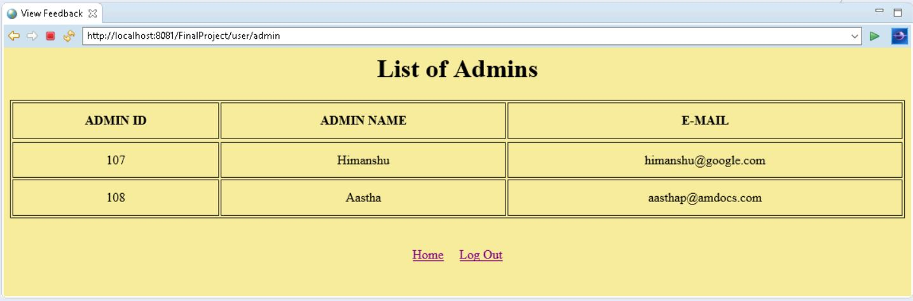
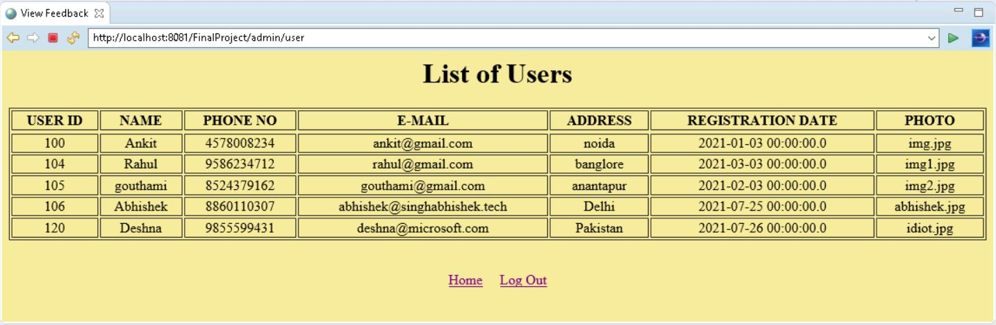
USER AND
ADMIN LIST

Slide 16
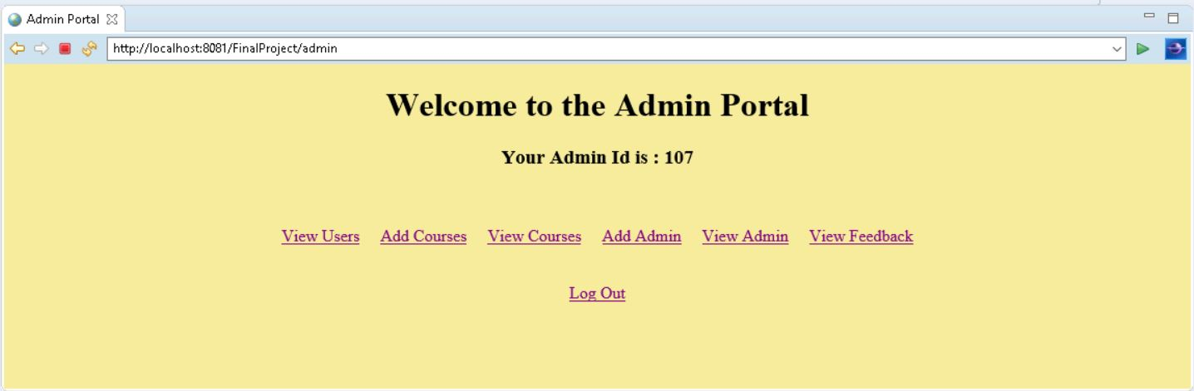
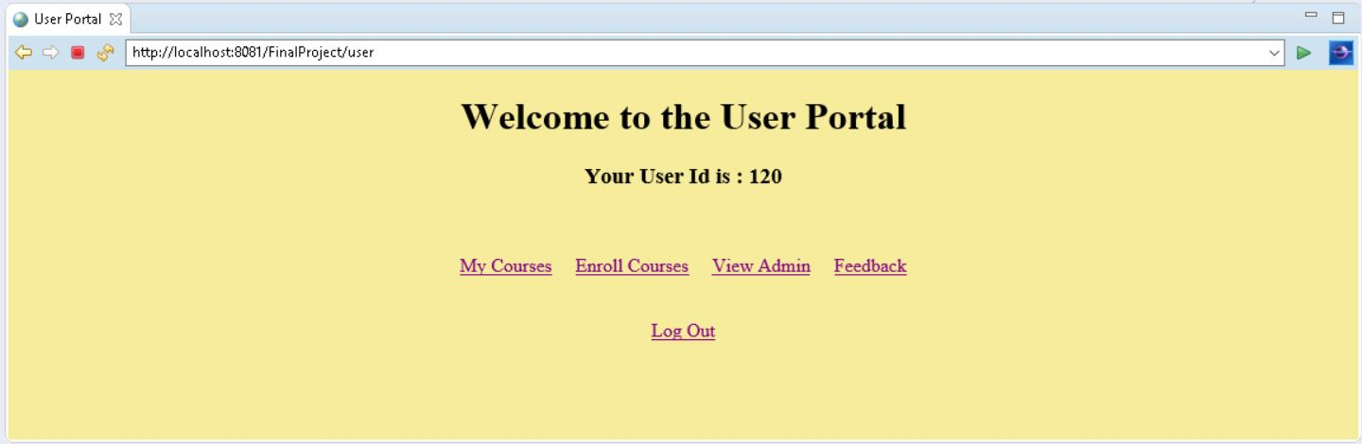
ADMIN
USER

Slide 17
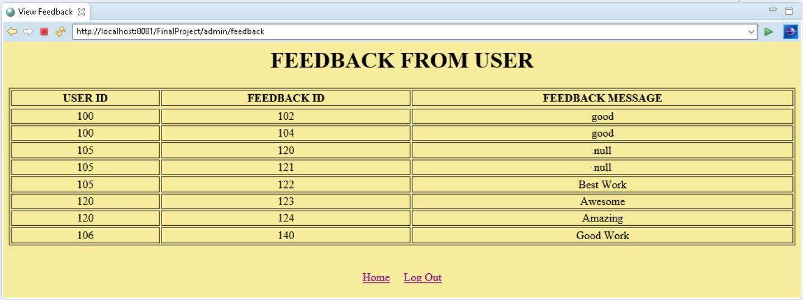
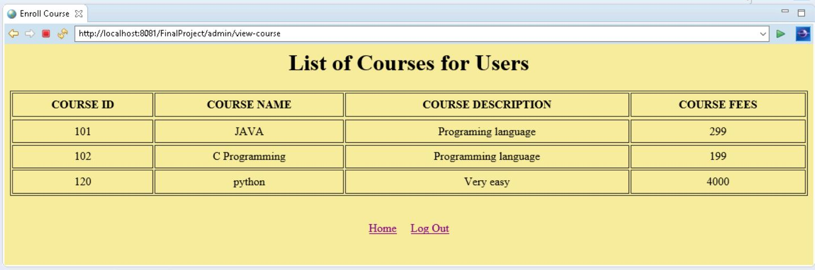
FEEDBACK
COURSE

Slide 18

THANK YOU

